Slide 2
Aim
To determine the diagnostic value of Kansas City Cardiomyopathy Questionnaire (KCCQ) in finding heart failure patients among people with type 2 diabetes
Determine the relationship between KCCQ and echo measures
Ascertain the incremental value of KCCQ in a risk score
Describe the diagnostic utility of KCCQ in detecting heart failure

Slide 3
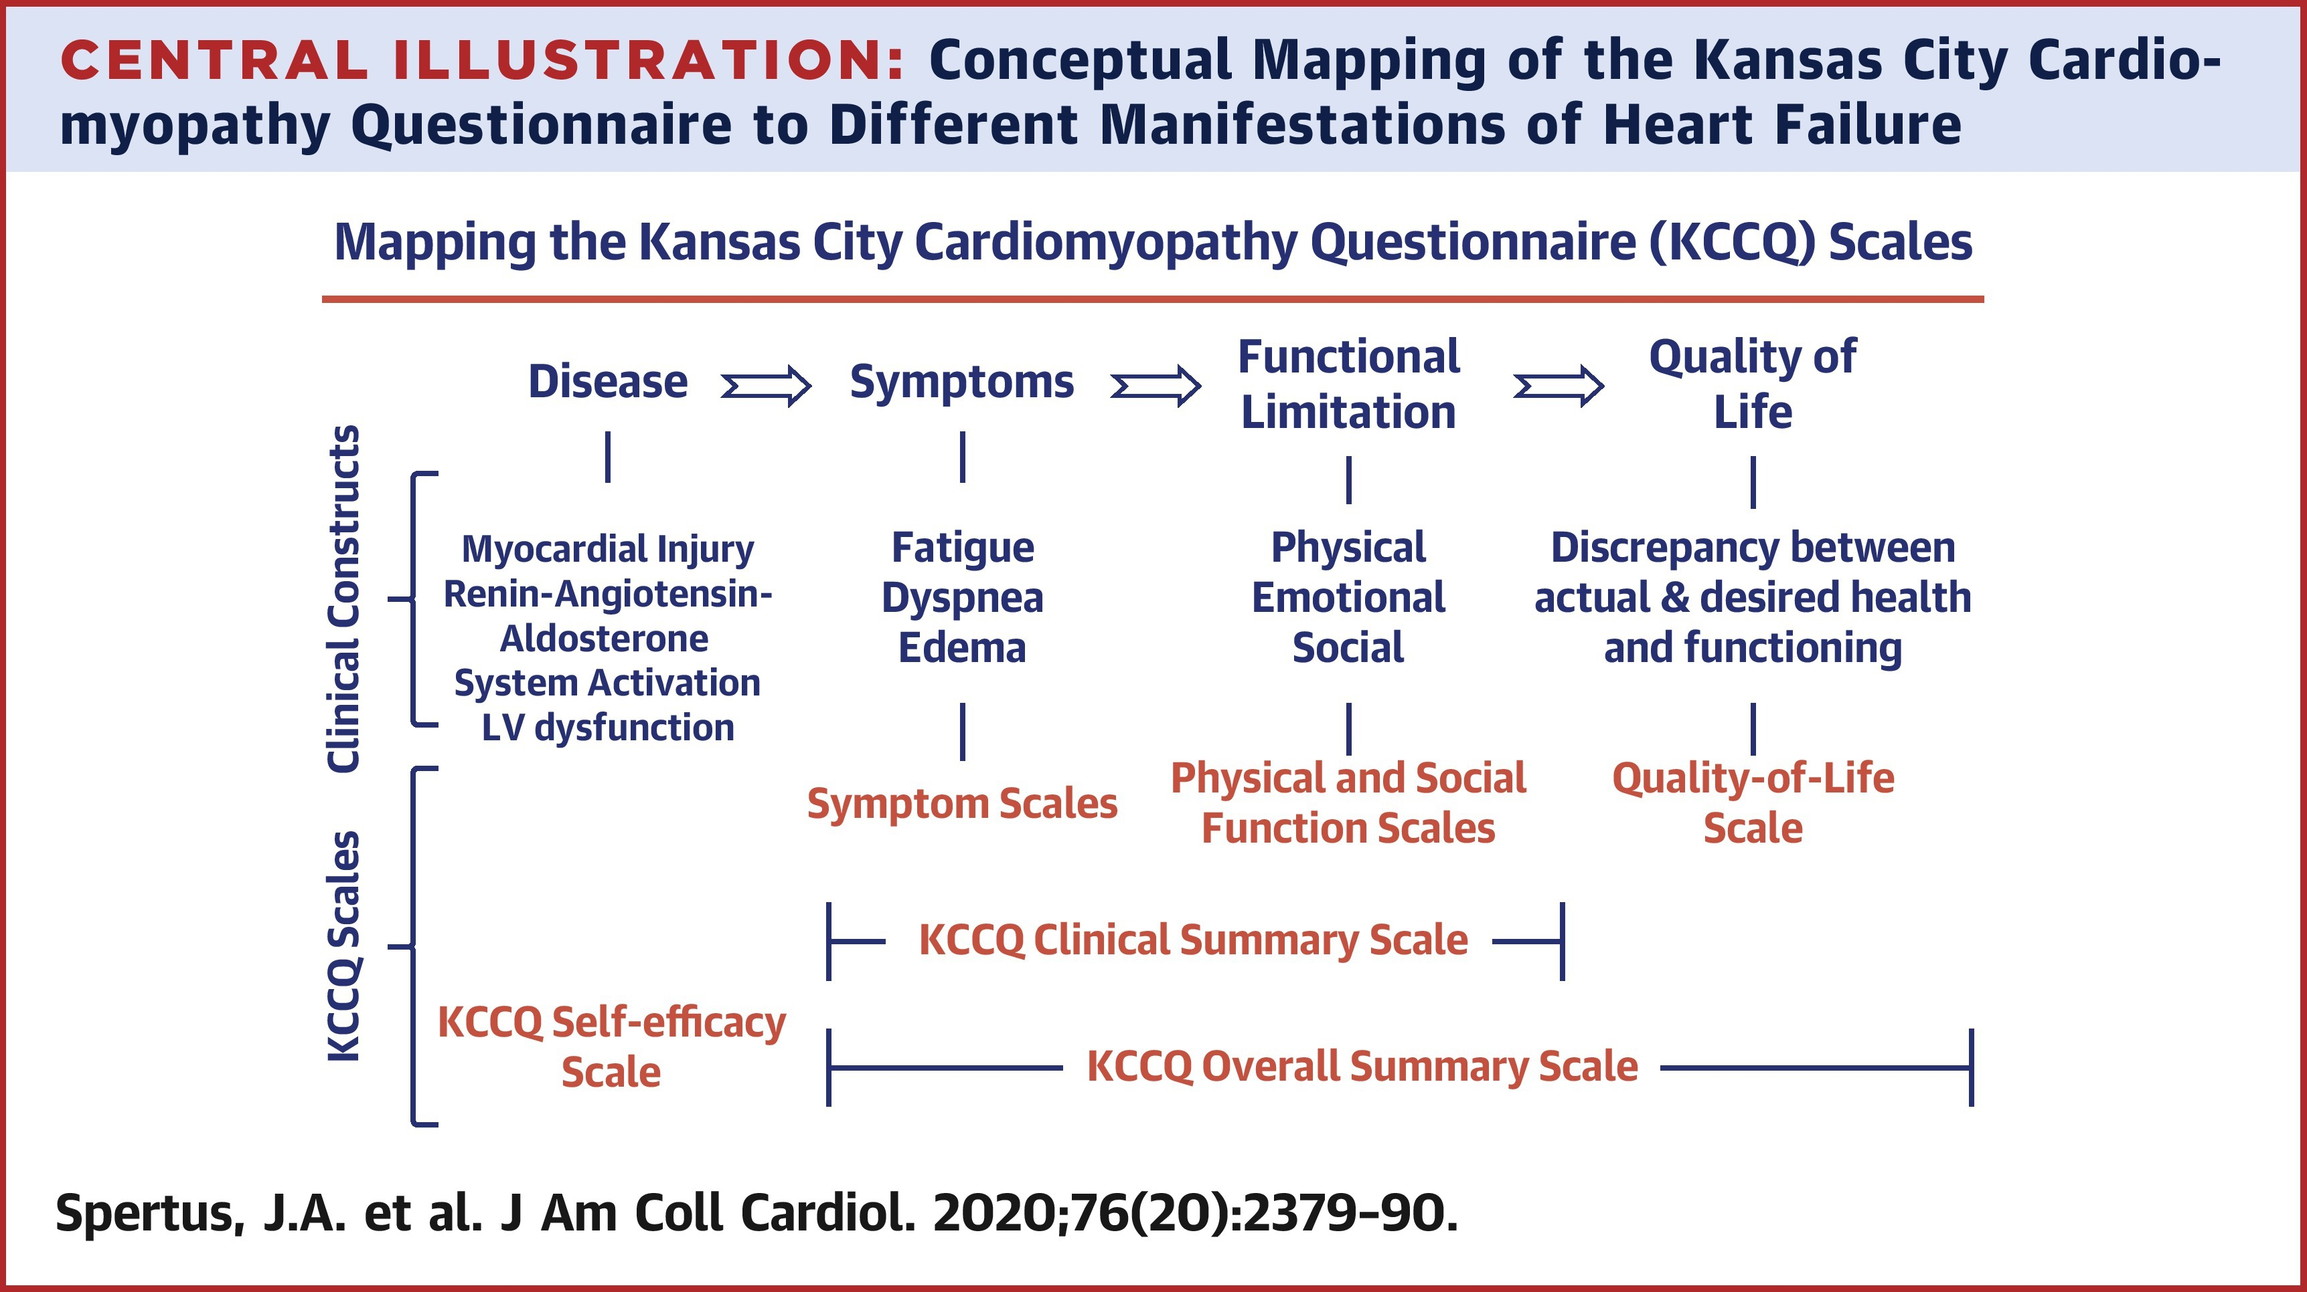
Kansas City Cardiomyopathy Questionnaire (KCCQ)

Slide 4
Subtypes of heart failure
Parameter | What it Measures | Abnormal Values | Clinical Significance
Global Longitudinal Strain (GLS) | Longitudinal myocardial deformation during systole | GLS ≥ −18% (borderline abnormal) or GLS ≥ −16% (abnormal) | Detects early systolic dysfunction, even when ejection fraction is normal.
Diastolic Function (e’) | Myocardial relaxation and LV filling pressures | E/e’ ≥ 14 or e’ < 8 cm/s | Indicates impaired myocardial relaxation and elevated filling pressures.
Left Ventricular Hypertrophy (LVH) | Left ventricular mass indexed to body size | LVMI ≥ 95 g/m² (F), ≥115 g/m² (M) | Reflects structural remodeling and chronic pressure overload (e.g., hypertension).
Left Atrial Enlargement (LAE) | Left atrial volume indexed to body size | LAVI > 34 ml/m² | Indicates chronic diastolic dysfunction and increased LV filling pressures.

Slide 5
Methods

Slide 6
 | Overall, N = 512¹ | No symptoms, N = 389 | No symptoms defined by KCCQ, N = 70 | Symptoms defined by KCCQ, N = 53
Gender
Male | 333 (66%) | 269 (71%) | 39 (57%) | 25 (47%)
Female | 170 (34%) | 112 (29%) | 30 (43%) | 28 (53%)
Age | 70 (64, 75) | 70 (62, 75) | 72 (67, 76) | 72 (65, 78)
BMI | 28.3 (25.1, 32.3) | 27.5 (24.6, 30.8) | 29.7 (27.0, 33.7) | 31.6 (28.9, 39.4)
Diabetes duration | 13 (6, 20) | 13 (7, 20) | 10 (4, 20) | 12 (2, 21)
watch_dm_risk_score | 9.00 (7.00, 11.00) | 9.00 (7.00, 11.00) | 9.00 (8.00, 11.50) | 10.00 (8.00, 13.25)
bp_syst_mean | 124 (113, 134) | 123 (113, 134) | 126 (113, 137) | 123 (116, 133)
bp_diast_mean | 70 (64, 78) | 70 (64, 78) | 71 (64, 76) | 69 (65, 78)
prior_ischemic_event | 35 (12%) | 23 (11%) | 7 (18%) | 5 (19%)
prior_PCI | 31 (11%) | 21 (9.8%) | 3 (8.6%) | 7 (27%)
MV E / E' Sept () | 10.3 (8.6, 12.9) | 10.2 (8.5, 12.4) | 10.0 (8.6, 13.1) | 11.8 (9.2, 13.9)
lvmi | 75 (63, 87) | 74 (62, 86) | 79 (68, 93) | 74 (60, 85)
lavi | 31 (26, 38) | 31 (25, 37) | 32 (27, 39) | 31 (24, 39)
gls_av | 18.30 (16.70, 19.70) | 18.40 (16.73, 19.70) | 18.35 (17.07, 20.13) | 17.20 (15.10, 18.70)
¹ n (%); Median (IQR)

Slide 7
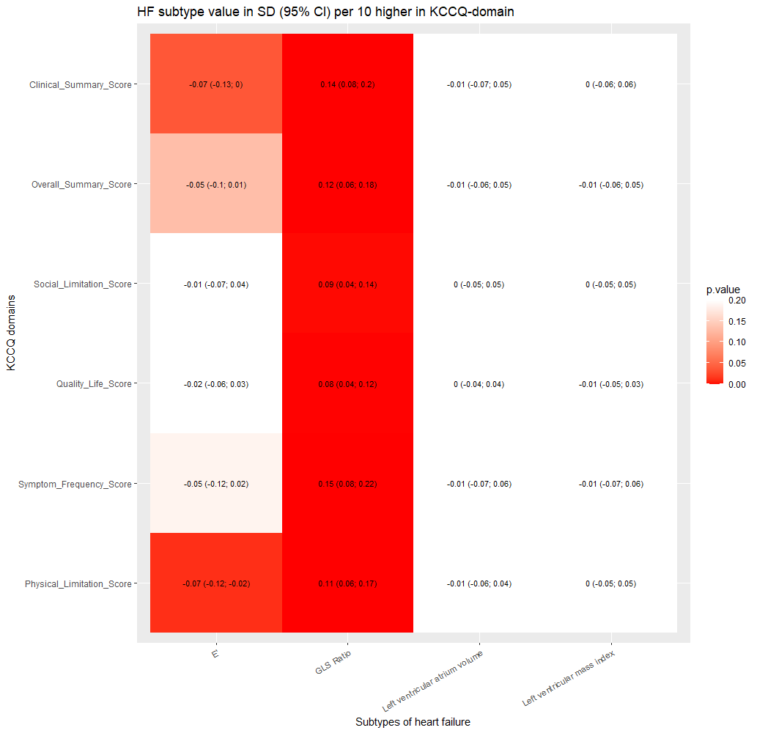
1. Findings KCCQ correlates with certain echo parameters
Adjusted for age and sex

Slide 8
Incremental value to simple risk score variables

Slide 10
Notes:
Incremental value

Slide 11
Describe the diagnostic utility of KCCQ

Slide 12

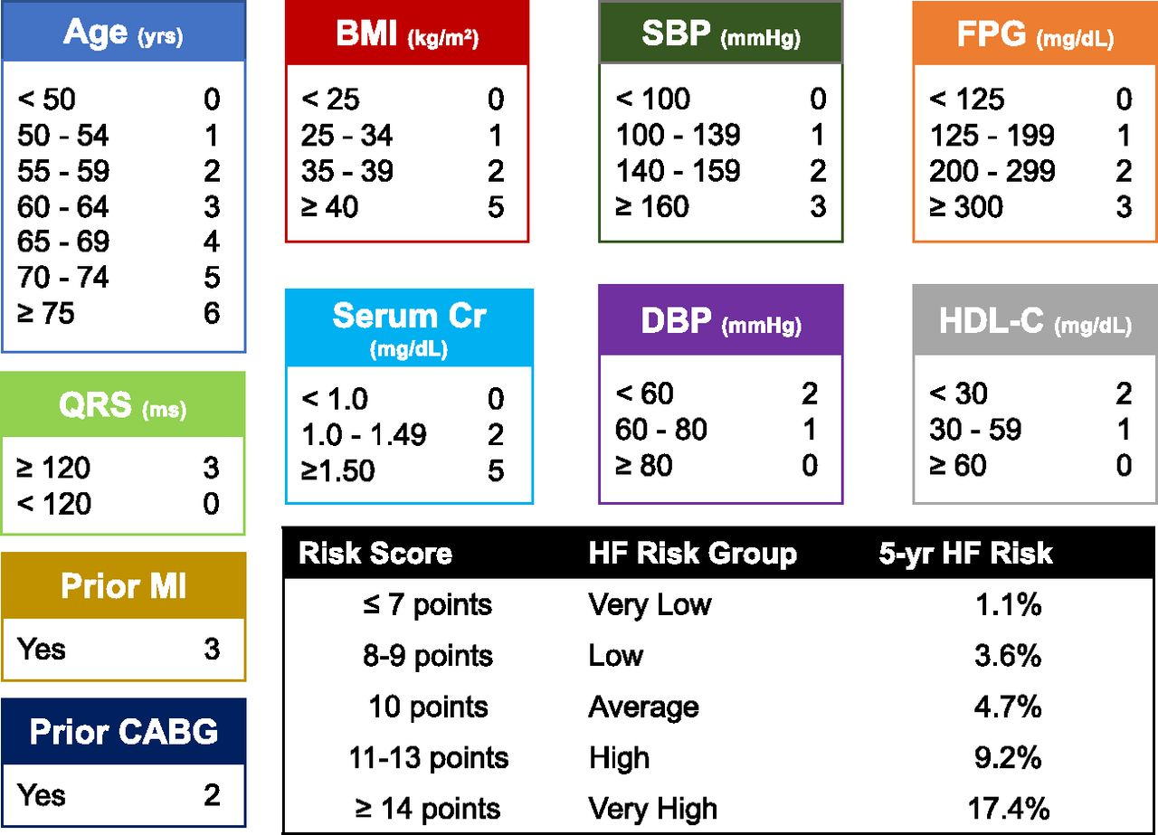
From: Machine Learning to Predict the Risk of Incident Heart Failure Hospitalization Among Patients With Diabetes: The WATCH-DM Risk Score
Diabetes Care. 2019;42(12):2298-2306. doi:10.2337/dc19-0587
Figure Legend:
The WATCH-DM score for 5-year HF incidence and the five risk groups by quintiles of WATCH-DM (very low ≤7, low 8–9, average 10, high 11–13, and very high ≥14). CABG, coronary artery bypass grafting; CR, creatinine; DBP, diastolic blood pressure; FPG, fasting plasma glucose; HDL-C, HDL cholesterol; MI, myocardial infarction; SBP, systolic blood pressure; yrs, years.
Date of Download: 1/13/2025
Copyright © 2025 American Diabetes Association. All rights reserved.
Notes:
WATCH-DM for comparison

Slide 13
Symptoms | Any subtype of HF
 | Normal | Abnormal
Any symptoms of shotness of breath or swealling
Absent | 167 (35) | 192 (40.3)
Present | 48 (10.1) | 70 (14.7)
Specificity/Sensitivity | 77.7 (71.5; 83.1) | 26.7 (21.5; 32.5)
NPV/PPV | 46.5 (41.3; 51.8) | 59.3 (49.9; 68.3)
Clinical Score 90 cutoff
above | 184 (38.6) | 211 (44.2)
below | 31 (6.5) | 51 (10.7)
Specificity/Sensitivity | 85.6 (80.2; 90) | 19.5 (14.9; 24.8)
NPV/PPV | 46.6 (41.6; 51.6) | 62.2 (50.8; 72.7)
Clinical Score 75 cutoff
above | 196 (41.1) | 231 (48.4)
below | 19 (4) | 31 (6.5)
Specificity/Sensitivity | 91.2 (86.5; 94.6) | 11.8 (8.2; 16.4)
NPV/PPV | 45.9 (41.1; 50.8) | 62 (47.2; 75.3)
WATCH-DM high risk (score > 11)
Below high risk | 84 (36.2) | 73 (31.5)
High-risk | 26 (11.2) | 49 (21.1)
Specificity/Sensitivity | 76.4 (67.3; 83.9) | 40.2 (31.4; 49.4)
NPV/PPV | 53.5 (45.4; 61.5) | 65.3 (53.5; 76)
Symptoms + WATCH-DM high risk (score > 11)
No symptoms | 167 (42) | 192 (48.2)
Symptoms + high risk | 12 (3) | 27 (6.8)
Specificity/Sensitivity | 93.3 (88.6; 96.5) | 12.3 (8.3; 17.4)
NPV/PPV | 46.5 (41.3; 51.8) | 69.2 (52.4; 83)
Notes:
What is a meaningful sensitivity and specificity

Slide 14
Symptoms | Diastolic dysfunction (E/e’≥ 14) |  | GLS impaired (GLS ≥ −16%) |  | Left atrium enlargement (Left atrial volume index >34 ml/m2) |  | Left ventricular hypertrophy (LVMI ≥95 g/m2 (F), ≥115 g/m2 (M))
 | Normal | Abnormal | Normal | Abnormal | Normal | Abnormal | Normal | Abnormal
Any symptoms of shotness of breath or swealling
Absent | 311 (67) | 39 (8.4) | 310 (64.6) | 56 (11.7) | 250 (49.1) | 136 (26.7) | 373 (73) | 15 (2.9)
Present | 97 (20.9) | 17 (3.7) | 87 (18.1) | 27 (5.6) | 75 (14.7) | 48 (9.4) | 111 (21.7) | 12 (2.3)
Specificity/Sensitivity | 76.2 (71.8; 80.3) | 30.4 (18.8; 44.1) | 78.1 (73.7; 82.1) | 32.5 (22.6; 43.7) | 76.9 (72; 81.4) | 26.1 (19.9; 33.1) | 77.1 (73.1; 80.7) | 44.4 (25.5; 64.7)
NPV/PPV | 88.9 (85.1; 92) | 14.9 (8.9; 22.8) | 84.7 (80.6; 88.2) | 23.7 (16.2; 32.6) | 64.8 (59.8; 69.5) | 39 (30.4; 48.2) | 96.1 (93.7; 97.8) | 9.8 (5.1; 16.4)
Clinical Score 90 cutoff
above | 341 (73.5) | 43 (9.3) | 342 (71.2) | 58 (12.1) | 272 (53.4) | 151 (29.7) | 405 (79.3) | 20 (3.9)
below | 67 (14.4) | 13 (2.8) | 55 (11.5) | 25 (5.2) | 53 (10.4) | 33 (6.5) | 79 (15.5) | 7 (1.4)
Specificity/Sensitivity | 83.6 (79.6; 87) | 23.2 (13; 36.4) | 86.1 (82.4; 89.4) | 30.1 (20.5; 41.2) | 83.7 (79.2; 87.5) | 17.9 (12.7; 24.3) | 83.7 (80.1; 86.9) | 25.9 (11.1; 46.3)
NPV/PPV | 88.8 (85.2; 91.8) | 16.2 (8.9; 26.2) | 85.5 (81.7; 88.8) | 31.2 (21.3; 42.6) | 64.3 (59.5; 68.9) | 38.4 (28.1; 49.5) | 95.3 (92.8; 97.1) | 8.1 (3.3; 16.1)
Clinical Score 75 cutoff
above | 370 (79.7) | 46 (9.9) | 366 (76.2) | 66 (13.8) | 291 (57.2) | 165 (32.4) | 434 (84.9) | 24 (4.7)
below | 38 (8.2) | 10 (2.2) | 31 (6.5) | 17 (3.5) | 34 (6.7) | 19 (3.7) | 50 (9.8) | 3 (0.6)
Specificity/Sensitivity | 90.7 (87.4; 93.3) | 17.9 (8.9; 30.4) | 92.2 (89.1; 94.6) | 20.5 (12.4; 30.8) | 89.5 (85.7; 92.6) | 10.3 (6.3; 15.7) | 89.7 (86.6; 92.2) | 11.1 (2.4; 29.2)
NPV/PPV | 88.9 (85.5; 91.8) | 20.8 (10.5; 35) | 84.7 (81; 88) | 35.4 (22.2; 50.5) | 63.8 (59.2; 68.2) | 35.8 (23.1; 50.2) | 94.8 (92.3; 96.6) | 5.7 (1.2; 15.7)
WATCH-DM high risk (score > 11)
Below high risk | 142 (60.2) | 18 (7.6) | 130 (57) | 25 (11) | 112 (47.5) | 48 (20.3) | 156 (65.5) | 5 (2.1)
High-risk | 59 (25) | 17 (7.2) | 51 (22.4) | 22 (9.6) | 43 (18.2) | 33 (14) | 73 (30.7) | 4 (1.7)
Specificity/Sensitivity | 70.6 (63.8; 76.8) | 48.6 (31.4; 66) | 71.8 (64.7; 78.2) | 46.8 (32.1; 61.9) | 72.3 (64.5; 79.1) | 40.7 (29.9; 52.2) | 68.1 (61.7; 74.1) | 44.4 (13.7; 78.8)
NPV/PPV | 88.8 (82.8; 93.2) | 22.4 (13.6; 33.4) | 83.9 (77.1; 89.3) | 30.1 (19.9; 42) | 70 (62.3; 77) | 43.4 (32.1; 55.3) | 96.9 (92.9; 99) | 5.2 (1.4; 12.8)
Symptoms + WATCH-DM high risk (score > 11)
No symptoms | 311 (79.9) | 39 (10) | 310 (76.9) | 56 (13.9) | 250 (58.7) | 136 (31.9) | 373 (87.1) | 15 (3.5)
Symptoms + high risk | 31 (8) | 8 (2.1) | 23 (5.7) | 14 (3.5) | 21 (4.9) | 19 (4.5) | 37 (8.6) | 3 (0.7)
Specificity/Sensitivity | 90.9 (87.4; 93.8) | 17 (7.6; 30.8) | 93.1 (89.8; 95.6) | 20 (11.4; 31.3) | 92.3 (88.4; 95.1) | 12.3 (7.5; 18.5) | 91 (87.8; 93.6) | 16.7 (3.6; 41.4)
NPV/PPV | 88.9 (85.1; 92) | 20.5 (9.3; 36.5) | 84.7 (80.6; 88.2) | 37.8 (22.5; 55.2) | 64.8 (59.8; 69.5) | 47.5 (31.5; 63.9) | 96.1 (93.7; 97.8) | 7.5 (1.6; 20.4)

Slide 15
Conclusion
KCCQ are associated with diastolic dysfunction, measure by E prime, and systolic function, measured by GLS. No relationship was found in structural measures of heart failure.
Adding KCCQ to simple risk variables in a risk model does not improve overall detection of heart failure but modestly improves the detection of abnormal global longitudinal strain.
Sensitivity of KCCQ and overall heart failure symptoms is poor but show strong specificity compared to risk scores. Positive predictive value of the KCCQ are comparable to WATCH-DM risk score. 33.4 individuals with type 2 diabetes has to be screened for low KCCQ clinical summary score < 75 to find one case compared to 6.1 for WATCH-DM.
Across abnormal ECHO measures was the diagnostic utility of KCCQ best on global longitudinal strain.

